Slide 1

Generative Agent ㅤroject
모진호, 유동균, 김종효, 김민서, 신우림, 박은주

Slide 2
0. Contents
1. Goal of the Project
2. Generative Agents: Interactive Simulacra of Human Behavior
3. Communicative Agents for Software Development: ChatDev

Slide 3

1. Goal of the Project
NPC
NPC
NPC
NPC
Virtual Map (ex. Game, Metaverse)

Slide 4
1. Goal of the Project
Interaction
NPC
NPC
NPC
NPC
Virtual Map

Slide 5
1. Goal of the Project
Interaction
NPC
NPC
NPC
NPC
Virtual Map

Slide 6
1. Goal of the Project
Interaction
NPC
NPC
NPC
NPC
Interaction between NPC objects w/o instruction

Slide 7
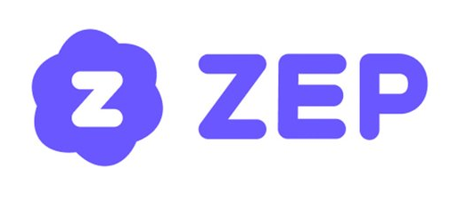
1. Goal of the Project
Interaction
NPC
NPC
NPC
NPC
Implementation in ZEP service

Slide 8
2. Generative Agents: Interactive Simulacra of Human Behavior

Slide 9
2. Generative Agents: Interactive Simulacra of Human Behavior

Slide 10
2. Generative Agents: Background (In 2022…)
NPC
NPC
NPC
NPC
Real World
Virtual World

Slide 11
2. Generative Agents: Background (In 2022…)
NPC
NPC
NPC
NPC
NPC
Virtual World
Limitations to Creating NPCs

Slide 12
2. Generative Agents: Background (In 2022…)
ChatGPT
The Appearance of LLM

Slide 13
2. Generative Agents: Background (In 2022…)
NPC
NPC
NPC
NPC
ChatGPT
Virtual World
Virtual World with ChatGPT NPCs

Slide 14
2. Generative Agents: Used Method
Used Method
- Identity Specification
- Planning
- Memory Stream & Retrieval
- Trie & NPC interaction

Slide 15
2. Generative Agents: Used Method – Identity Specification
Role: You are an artist who likes to take pictures
NPC 1
Developer
Role: You are a bright and brilliant programmer
NPC 2
Initial Identity Specification (by Real-World Developer)

Slide 16
2. Generative Agents: Used Method: Planning
Role: Lazy who …
Action: Sleeping…
What are you going to do at 9:00
NPC 1
NPC 1

Slide 17
2. Generative Agents: Used Method: Memory Stream
09:00 Sleeping
10:00 Sleeping
11:00 Sleeping
…
14:00 Wake
14:01 Stretching
14:10 Brushing Teeth
Memory Stream of NPC 1

Slide 18
2. Generative Agents: Used Method: Planning-V2 (Retrieval)
Memory Stream of NPC 1
He awake, stretched, and brushed teeth
Role: Lazy who …
Action: Work
What are you going to do at 14:20
NPC 1
NPC 1
Extract key memories from Memory Stream

Slide 19
2. Generative Agents: Used Method: Planning-V2 (Retrieval)
Memory Stream of NPC 1
Retrieval
He awake, stretched, and brushed teeth
Role: Lazy who …
Action: Work
What are you going to do at 14:20
NPC 1
NPC 1
Use Retrieval to Extract key memories

Slide 20
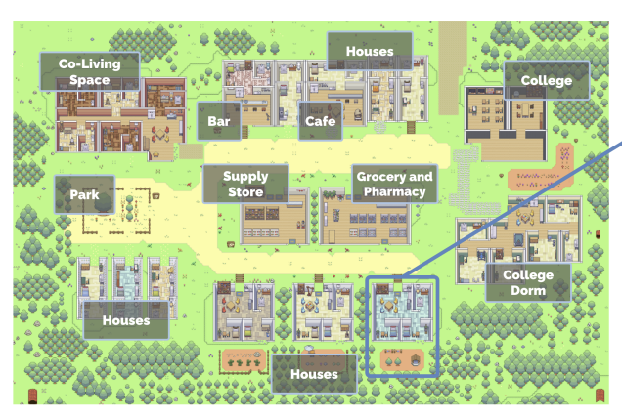
2. Generative Agents: Used Method: Trie & Interaction
09:00 Sleeping
10:00 Sleeping
11:00 Sleeping
…
14:00 Wake
14:01 Stretching
14:10 Brushing Teeth
14:20 Go to work
NPC 1
How can we move NPC (In Virtual World?)

Slide 21
2. Generative Agents: Used Method: Trie
Class 101
Floor 1
Class 202
College
Floor 2
Class 201
Floor 3
Class 301
Using Pre-Defined Trie Stucture

Slide 22
2. Generative Agents: Used Method: Trie
09:00 Sleeping
10:00 Sleeping
11:00 Sleeping
…
14:00 Wake
14:01 Stretching
14:10 Brushing Teeth
14:20 Go to work
(College: Floor 3: Class 301)
Class 101
Floor 1
Class 202
College
Floor 2
Class 201
Floor 3
Class 301
NPC 1
Using Pre-Defined Trie Stucture

Slide 23
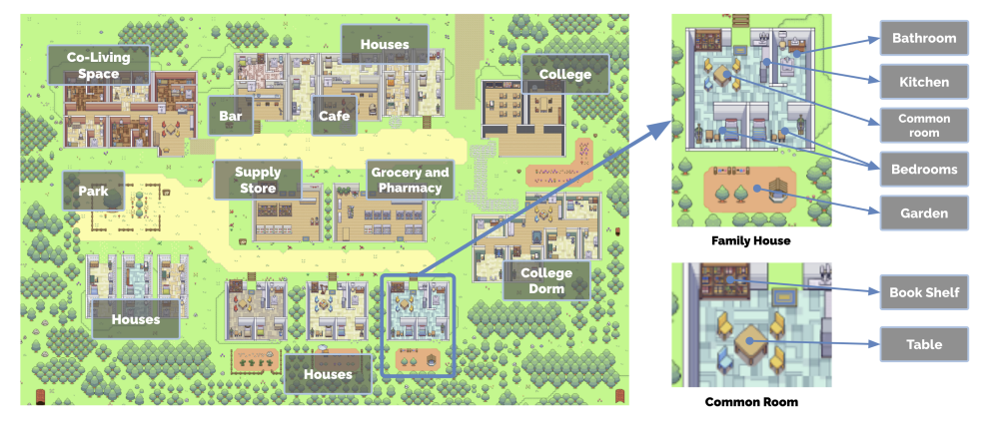
2. Generative Agents: Used Method: Trie

Slide 24
2. Generative Agents: Used Method: Interaction
Now we have…
1. NPC make a plan based on their own Identity
2. NPC make a plan based on their Memory-Stream & Retrieval
3. NPC can move virtual world based on Trie
How about Interaction between NPC?

Slide 25

2. Generative Agents: Used Method: Trie & Interaction
Class 101
Class 101
Floor 1
Floor 1
Class 202
Class 202
College
Floor 2
College
Floor 2
Class 201
Class 201
Floor 3
Floor 3
NPC 1
Class 301
NPC 2
Class 301
When ${trie}_{npc1}≠{trie}_{npc2}$, no interaction

Slide 26

2. Generative Agents: Used Method: Trie & Interaction
Class 101
Class 101
Floor 1
Floor 1
Class 202
Class 202
College
Floor 2
College
Floor 2
Class 201
Class 201
Floor 3
Floor 3
NPC 1
Class 301
NPC 2
Class 301
When ${trie}_{npc1}={trie}_{npc2}$, interaction occur (+when met in load)

Slide 27
2. Generative Agents: Used Method: Trie & Interaction
Memory Stream
Memory Stream
NPC 1: I will open party!
NPC 2: Wow! When party start?
NPC 1: Saturday, 9 o’clock.
NPC 2: I will participate.
NPC 1
NPC 2
During Interaction, They share their knowledge/events

Slide 28
2. Generative Agents: Used Method: Trie & Interaction
Open a Party
NPC 4
NPC 5
NPC 1
NPC 2
NPC 3
NPC 6
As time goes by, information spreads - Information Diffusion

Slide 29
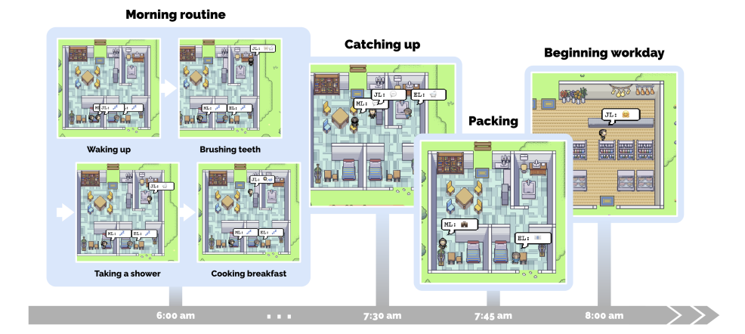
2. Generative Agents: Example&Experiments
Planning Example

Slide 30
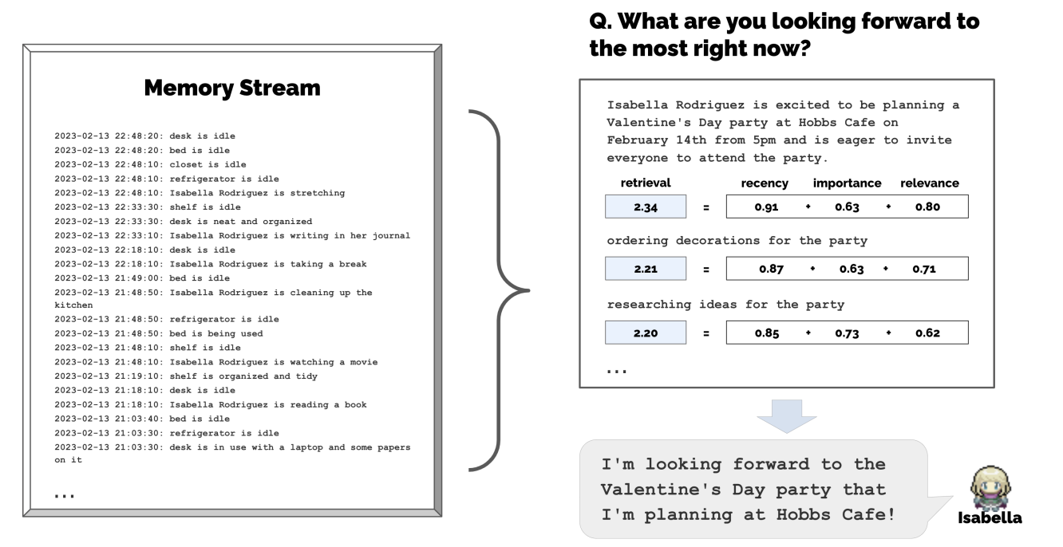
2. Generative Agents: Example&Experiments
Planning Example

Slide 31
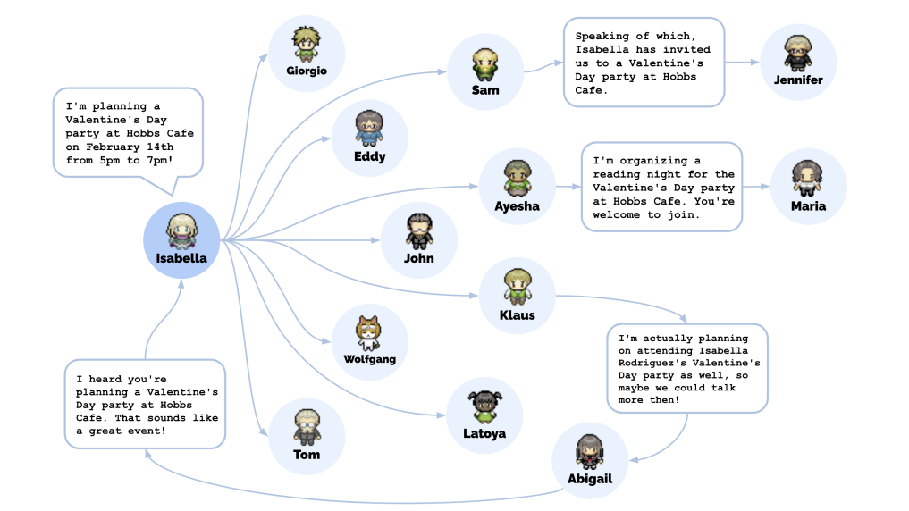
2. Generative Agents: Example&Experiments
Information Diffusion Example

Slide 32
3. Communicative Agents for Software Development: ChatDev

Slide 33
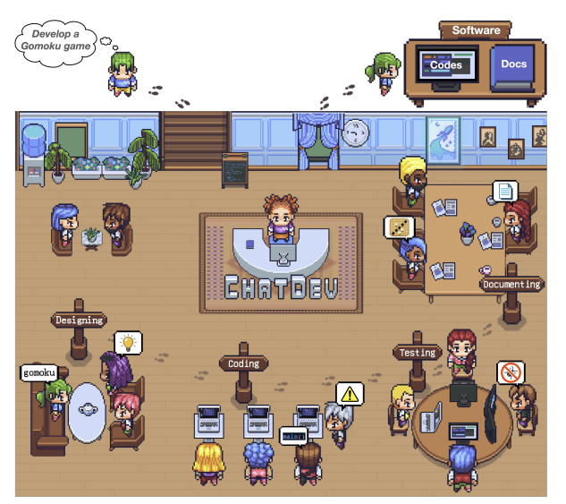
3. Communicative Agents for Software Development: ChatDev

Slide 34
3. Communicative Agents for Software Development: ChatDev
Software Development
Design -> Develop -> Testing -> Document
Subject: Make Auto-Software Development Company!

Slide 35
3. Communicative Agents for Software Development: ChatDev
Determine topic, programming language, …
Design -> Develop -> Testing -> Document

Slide 36
3. Communicative Agents for Software Development: ChatDev
Developing/Coding Programming
Design -> Develop -> Testing -> Document

Slide 37
3. Communicative Agents for Software Development: ChatDev
Debugging code, Complement code, …
Design -> Develop -> Testing -> Document

Slide 38
3. Communicative Agents for Software Development: ChatDev
Writing SRS, API document, etc …
Design -> Develop -> Testing -> Document

Slide 39
3. Communicative Agents for Software Development: Used Method
Role Specialization
Memory Stream
Consensus system

Slide 40
3. Communicative Agents for Software Development: Role Specification
Role: You are an Designer
Role: You are an CEO
Role: You are an CTO
Designer
CEO
CTO
Role Specification (= Identity Initialization)

Slide 41
3. Communicative Agents for Software Development: Memory Stream
Common Memory Stream
CEO
Designer
Programmer
CPO
Everyone memorize previous meeting contents

Slide 42
3. Communicative Agents for Software Development: Consensus system
CEO
Designer
Programmer
Programmer
(Make maze!)
Task
(Given by User)
Design -> Develop -> Testing -> Document
Designer
Programmer
CTO
CPO
Start program with given user specific task

Slide 43
3. Communicative Agents for Software Development: Consensus system
Python!
CEO
Designer
Programmer
Programmer
(Make maze!)
Task
(Given by User)
Design -> Develop -> Testing -> Document
C++!
Designer
Programmer
CTO
CPO
If not consensus, repeat current part again

Slide 44
3. Communicative Agents for Software Development: Consensus system
Thinking…
CEO
Designer
Programmer
Programmer
(Make maze!)
Task
(Given by User)
Design -> Develop -> Testing -> Document
Thinking…
Designer
Programmer
CTO
CPO
If not consensus, repeat current part again

Slide 45
3. Communicative Agents for Software Development: Consensus system
Python!
CEO
Designer
Programmer
Programmer
(Make maze!)
Task
(Given by User)
Design -> Develop -> Testing -> Document
Python!
Designer
Programmer
CTO
CPO
If consensus, go to the next stage

Slide 46
3. Communicative Agents for Software Development: Consensus system
CEO
Designer
Programmer
Programmer
(Make maze!)
Task
(Given by User)
Design -> Develop -> Testing -> Document
Designer
Programmer
CTO
CPO

Slide 47
3. Communicative Agents for Software Development: Consensus system
Implement C
CEO
Designer
Programmer
Programmer
(Make maze!)
Task
(Given by User)
Design -> Develop -> Testing -> Document
What is not implemented?
Designer
Programmer
CTO
CPO

Slide 48
3. Communicative Agents for Software Development: Consensus system
CEO
Designer
Programmer
Programmer
(Make maze!)
Task
(Given by User)
Design -> Develop -> Testing -> Document
(C implementing…)
Designer
Programmer
CTO
CPO

Slide 49
3. Communicative Agents for Software Development: Consensus system
Done!
CEO
Designer
Programmer
Programmer
(Make maze!)
Task
(Given by User)
Design -> Develop -> Testing -> Document
Done!
Designer
Programmer
CTO
CPO

Slide 50
3. Communicative Agents for Software Development: Consensus system
CEO
Designer
Programmer
Programmer
(Make maze!)
Task
(Given by User)
Design -> Develop -> Testing -> Document
I have error
(error message)
Designer
Programmer
CTO
CPO

Slide 51
3. Communicative Agents for Software Development: Consensus system
Add “n” in line 5
CEO
Designer
Programmer
Programmer
(Make maze!)
Task
(Given by User)
Design -> Develop -> Testing -> Document
I have error
(error message)
Designer
Programmer
CTO
CPO

Slide 52
3. Communicative Agents for Software Development: Consensus system
CEO
Designer
Programmer
Programmer
(Make maze!)
Task
(Given by User)
Design -> Develop -> Testing -> Document
Error fixed!
Designer
Programmer
CTO
CPO

Slide 53
3. Communicative Agents for Software Development: Consensus system
Test passed!
CEO
Designer
Programmer
Programmer
(Make maze!)
Task
(Given by User)
Design -> Develop -> Testing -> Document
Test passed!
Designer
Programmer
CTO
CPO

Slide 54
3. Communicative Agents for Software Development: Consensus system
CEO
Designer
Programmer
Programmer
(Make maze!)
Task
(Given by User)
Design -> Develop -> Testing -> Document
Designer
Programmer
CTO
CPO

Slide 55
3. Communicative Agents for Software Development: Consensus system
Wring document…
CEO
Designer
Programmer
Programmer
(Make maze!)
Task
(Given by User)
Design -> Develop -> Testing -> Document
Wring document…
Designer
Programmer
CTO
CPO

Slide 56
3. Communicative Agents for Software Development: Consensus system
Done!
CEO
Designer
Programmer
Programmer
(Make maze!)
Task
(Given by User)
Design -> Develop -> Testing -> Document
Done!
Designer
Programmer
CTO
CPO

Slide 57
3. Communicative Agents for Software Development: summary
Role Specialization
Memory Stream
Self-Reflection
Autonomous S.D.

Slide 58
Thank You

Slide 59
Appendix

Slide 60
3. Communicative Agents for Software Development: self-reflection
I have to
program with python
I have to program Maze!
Previously, It was python
Programmer
Programmer
Programmer
<Consensus> Python

Slide 61
2. Generative Agents

Slide 62
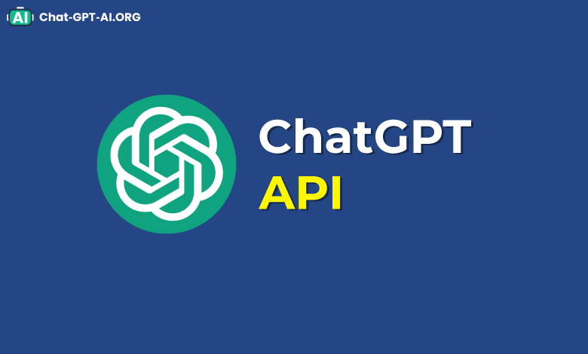
2. General Structure
ChatGPT

Slide 63
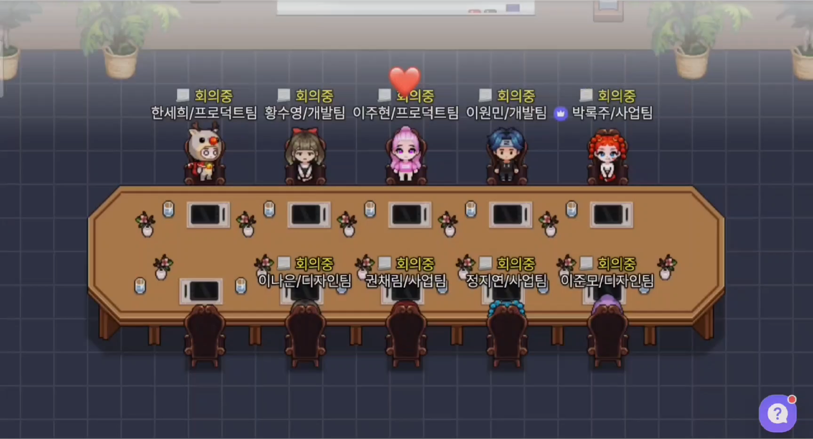
2. General Structure
Naver Zep

Slide 64

2. General Structure
httpPost
API
Naver Zep
Server
ChatGPT

Slide 65

2. General Structure
Persona
NPC

Slide 66
2. General Structure
Plan my day
Persona
ChatGPT
NPC

Slide 67
2. General Structure
Plan my day
Persona
Memory Stream
Plan
ChatGPT
NPC

Slide 68
2. General Structure
Plan my day
Persona
Memory Stream
Plan
Next Move
ChatGPT
NPC

Slide 69
2. General Structure
Plan my day
Persona
Memory Stream
Plan
Next Move
Act
ChatGPT
NPC

Slide 70
2. General Structure
Plan my day
Persona
Memory Stream
Plan
Next Move
Act
ChatGPT
NPC
Act
Naver Zep

Slide 71
2. General Structure
Plan my day
Persona
Memory Stream
Plan
Next Move
Act
ChatGPT
NPC
Act
Preceive
Naver Zep

Slide 72
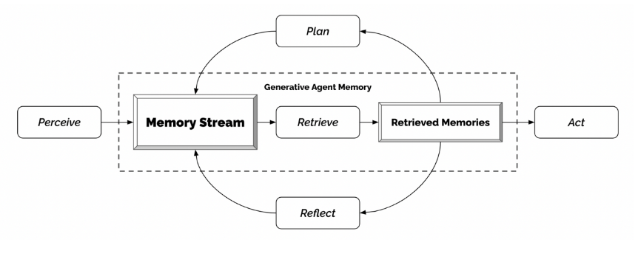
2. General Structure
NPC

Slide 73
3. Planning
1 주차 - 코드 리뷰 (zep JS 코드 방식 리뷰)
2주차 - 논문 리뷰 (3명씩 팀을 나눠서 2개의 논문을 리뷰)
－ 아이디어 구체화（컨셉잡기 등）
3주차 - 코드작성 (텍스트로 상호작용 및 ChatGPT api 연결)
4주차 - 3주차와 같음
5주차 - 3주차와 같음
6주차 - zep에서 NPC의 움직임 구현 (Zep script api를 활용함)
7주차 - 6주차와 같음
8주차 - NPC UI 구성
9주차 - 예비 주차
(*프로젝트 진행상황에 따라 변동가능)

